Slide 1
Basis of the Gospel

Slide 2
1 Corinthians 15: 1-6
“…by this Gospel, you are saved..”

Slide 3
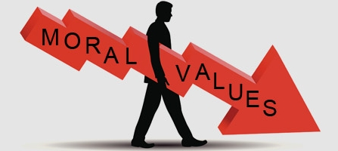
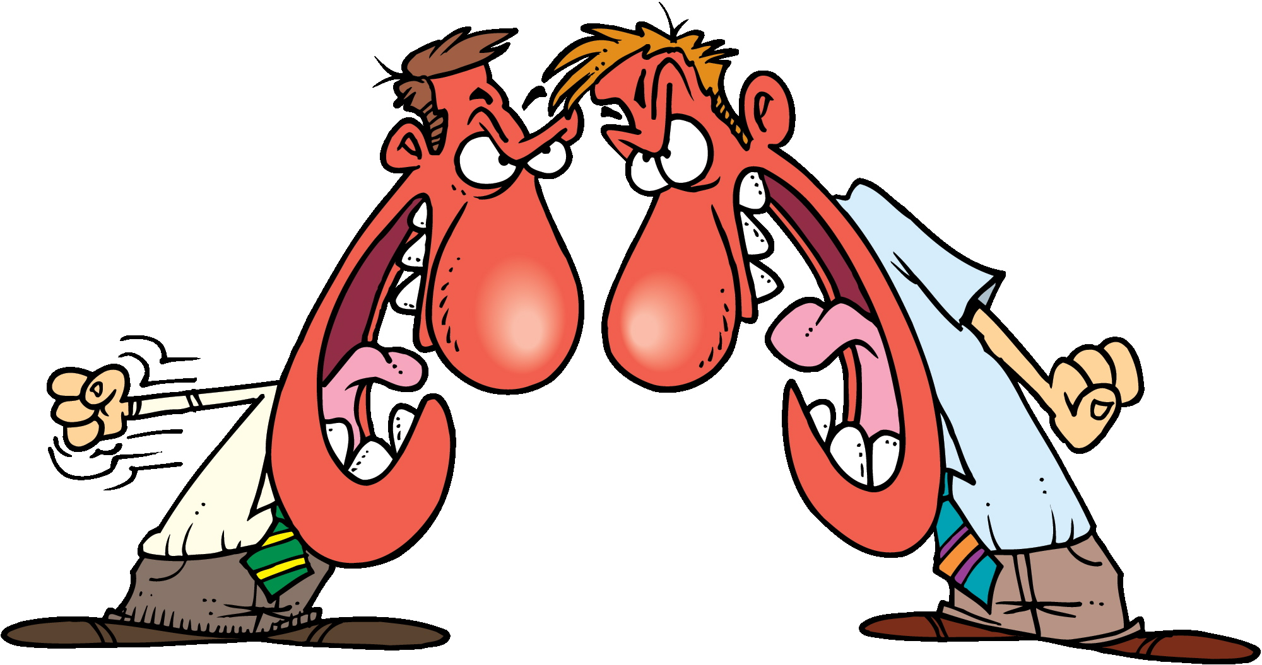
Paul’s deep concerns for the Church spiritually

Slide 4
Colossians 1: 19-20

Slide 5
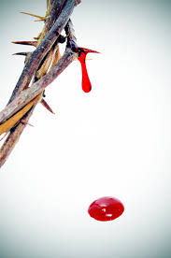
What does Jesus’s Blood on the Cross mean?
What did His Blood on the Cross secure?

Slide 6
Colossians 1:18
Pre-Eminence :
He is Above and Before ALL Things
He is Superior and Surpassing Everything

Slide 7
What does
Jesus’s Blood
on the Cross mean?

Slide 8
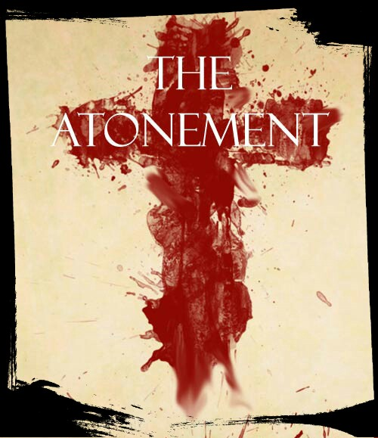
His Blood on the Cross is
ATONING BLOOD

Slide 9
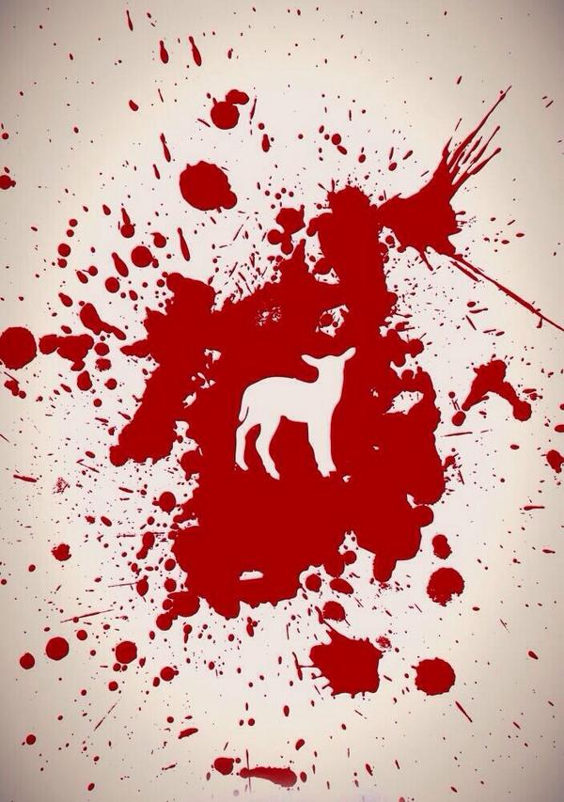
“Without the Shedding of Blood – there is No Forgiveness of Sin”

Slide 10
God has only
One Remedy for Sin
The Only Remedy God has ever had
The Only Remedy God ever offered to Man
The All-Sufficient Remedy with Power to Save
Hebrews 7:25

Slide 11
The Blood means the
Giving of the Life of the Son of God
For the Redemption of Lost Mankind
Life is in the Blood
Giving Himself a Ransom for Many
His Soul an Offering for Sin
Isaiah 53:11

Slide 12
2) What did His Blood on the Cross Secure?

Slide 13
Justification

Slide 14
When God “JUSTIFIES” a sinner
He is RESTORED to INNOCENCE in the sight of God

Slide 15
2. Propitiation

Slide 16
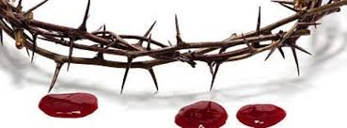
1 John 2:2
Propitiation means:
To Make Favor
To Appease

Slide 17
3. Redemption

Slide 18
Redemption:
From Sin
Of the Sinner
Psalm 106:10
Galatians 3: 13-14

Slide 19
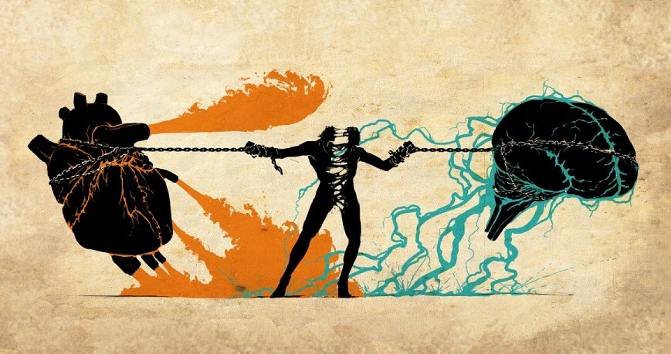
Romans 6:12
“ Therefore do not let sin reign in your mortal body so that you obey its evil desires”

Slide 20
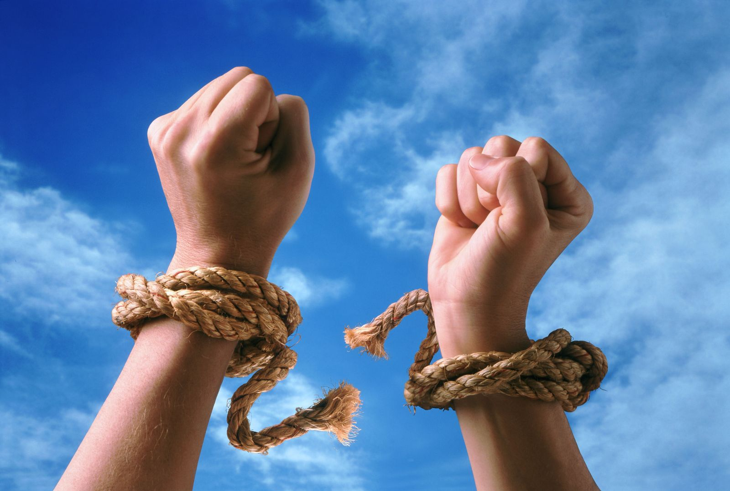
John 8:36
“So if the Son Sets you Free, You will be Free Indeed”

Slide 21
4. Forgiveness

Slide 22
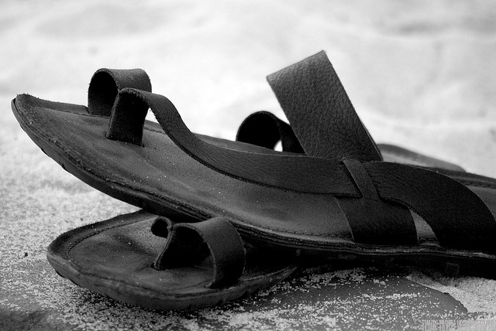
Forgiveness of Sins
God cannot compromise with sin without destroying His Holiness and Justice
The only “holy ground” is
the Blood of Jesus Christ

Slide 23
Forgiveness of Sins
Sin must be put away
Sin has come between men and God
Sin tramples God’s holiness, justice, mercy and grace

Slide 24
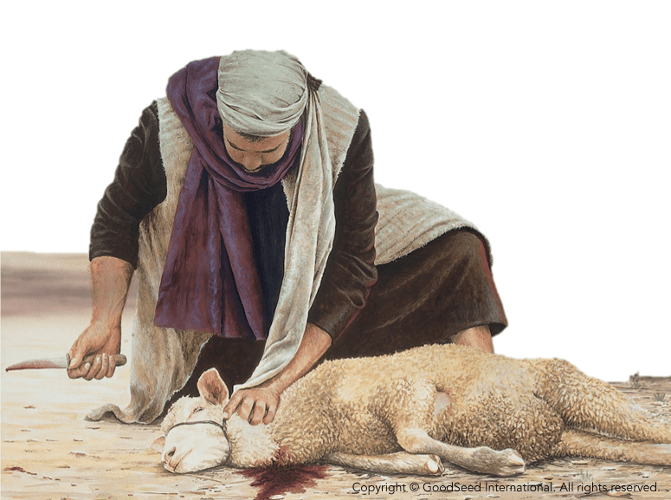
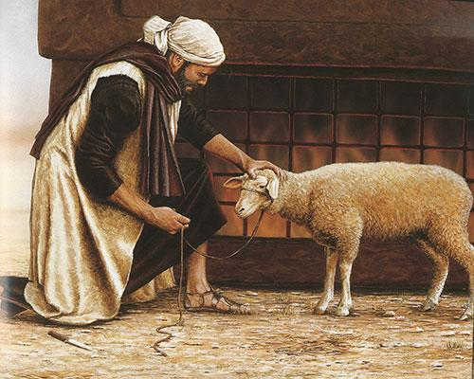
Day of Atonement
High Priest laid his hand on two Goats and confessed the sins of the people on the goat
One goat was killed and blood sprinkled on the mercy seat for atonement of people’s sin
One Goat was led out across the desert and disappeared - the “scapegoat”

Slide 25
5. Peace

Slide 26
Colossians 1: 19-20
“…by making Peace Through His Blood Shed on the Cross”
God gives us a Peace that Surpasses all understanding

